Slide 1
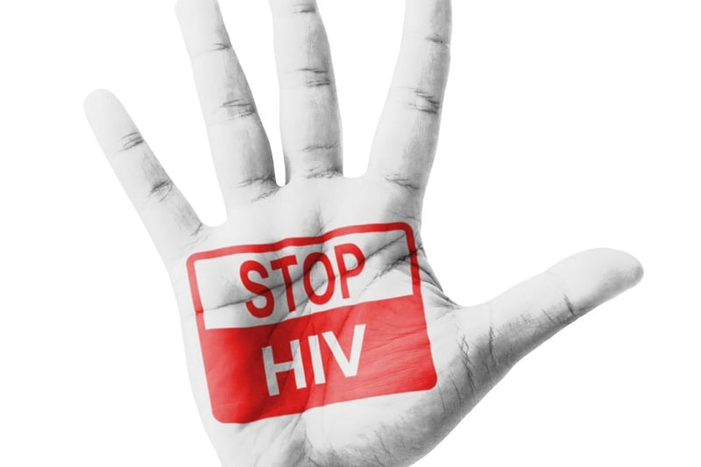
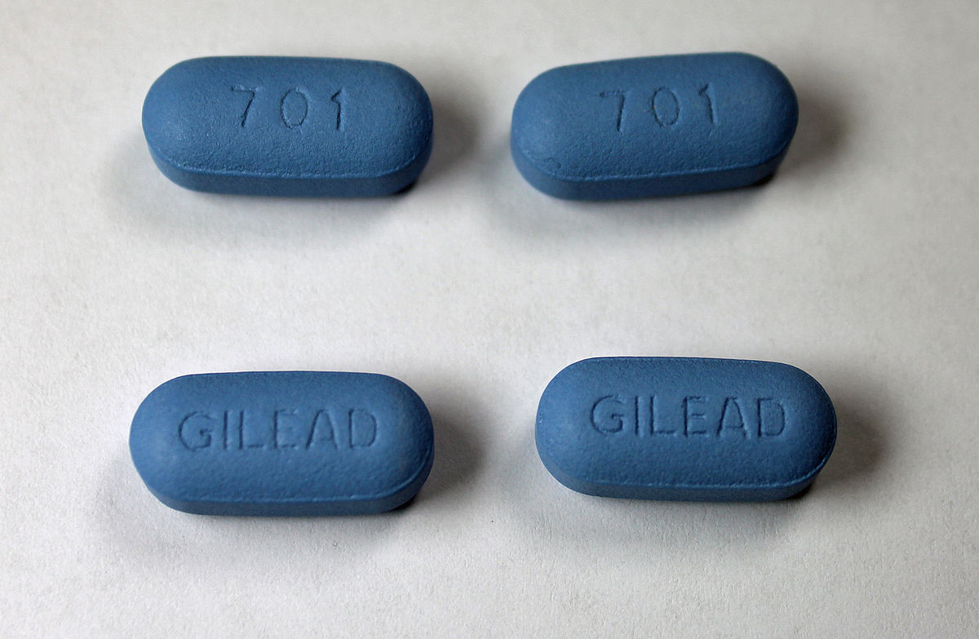
2 Discussion Questions
1. Given the advances made for the treatment and prevention of HIV, should HIV+ people be legally required to disclose their status to sexual partners? (Ch.3)
2. Should police be involved in advocating for and lobbying for criminal laws? (Ch. 4)

